Slide 1

Microsoft Azure Immersion Workshop: Infrastructure Migration
Session 8: Next Best Action

Slide 2
What should you think about when migrating to Azure Infrastructure?

Slide 3
No migration is ever linear or simple Drawn from 100s of engagements by FastTrack for Azure
Security and compliance
Migration plan
Specific migration workloads committed
Azure Foundations
Migration training
Technical skilling
Azure administration
Business strategy
Migration plan
Infrastructure security
Data protection
Incident response
Operations model
Technical resources
Cloud Strategy Team In Place (CDE)
Project management resources
Logging and monitoring
OS patching
High level business strategy
Key stakeholder sign off
Migration funding committed
Subscription design
Text
Text
Text
Text
Text
Text
Text
Text
Text
Text
Text
Text
Text
Text
Text
Text
Text
Text
Text
Text
Text
Text
Text
Text
Text
Text
Text
Text
Text
Text
Text
Text
Text
Text
Text
Text
Text
Text
Text
Text
Text
Text
Text
Text
Monitoring
Identity and access management
Backup
Financial analysis
Governance
Landing zone
Migration execution
Security RACI
Disaster recovery
TCO/ business case
Networking
Customer/ partner contract
Migration strategy
Identity
Shared responsibility model understood
Cloud operations
Configuration and change management
Pilot applications and VM identification
Partner support
Migration partner
Cost management
Cloud operational processes and run books
e2e test
Migration execution
Migration support
DevOps and automation
Azure operations partner
Migration targeted scope
Migration factory offering
Scan
Assessment
Workload owner buy-in or alignment
Discovery and assessment
Notes:
Real life migrations can be complex and messy to navigate.
This is from our FTA team which has been working with many many customers…

Slide 4
Streamline your migration journey with Microsoft And our verified Azure Migration Partners
Business strategy
Migration assessment and execution
Security and compliance
Cloud operations
High level business strategy
Key stakeholder sign off
Migration funding committed
Migration and Operation Partner
Assessment
Workload alignment
Migration strategy
Financial analysis
Migration execution
Specific migration workloads committed
Azure administration
Security
&
Governance
Networking Landing Zone
DevOps operation & automation
Identify Next Projects
Text
Text
Text
Text
Text
Text
Text
Text
Text
Text
Text
Text
Text
Text
Text
Text
Text
Text
Text
Text
Text
Text
Text
Text
Text
Text
Text
Text
Text
Text
Text
Text
Text
Text
Text
Text
Text
Text
Text
Text
Text
Text
Text
Text
Partner support
TCO/ business case
Technical skilling
Landing zone design
Cost-effective offers & incentives
Free tools: Azure Migrate
Expert help from specialized partners
Cost-effective offers & incentives
Free tools: Azure Migrate
Expert help from specialized partners
Holistic Infrastructure migration
In-depth assistance from FastTrack for Azure engineers
Technical skill building
Holistic Infrastructure migration
In-depth assistance from FastTrack for Azure engineers
Technical skill building
Azure Migration Program
Azure Migration Program
Discovery and assessment
Notes:
Real life migrations can be complex and messy to navigate.
This is from our FTA team which has been working with many many customers…

Slide 5
What are the top three most important things to remember?
Notes:
Think about the holistic Azure Core IaaS Stack across Linux and Windows and Hybrid deployment consideration
Using Azure Migrate as the tool
Joining AMP / Azure Advanced Specialization Partner Program / Azure Support

Slide 6
1. Think about the holistic Azure Core IaaS Stack across Linux and Windows and Hybrid deployment consideration
Notes:
Think about Windows Server migration alongside with Linux workload migration when designing your migration plan to Azure
Pick the right VM, storage options and think about Networking needs from the get go
For specialized workloads, use specialized solutions like Azure VMware solutions, Azure Red Hat OpenShift, SUSE Enterprise Linux with SAP on Azure, HPC certified workloads…etc
For workloads that cannot be migrated, consider using Azure Arc to build Hybrid deployment model and connect customer’s on-premises environment.
Joining AMP / Azure Advanced Specialization Partner Program / Azure Support

Slide 7
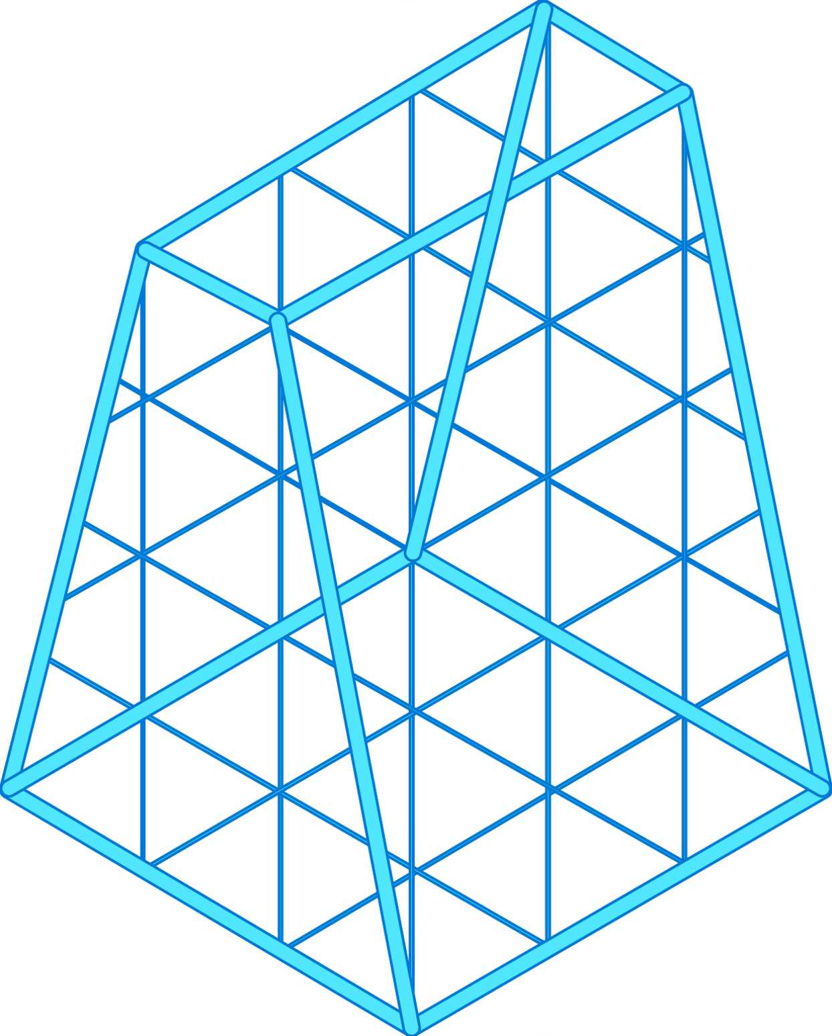


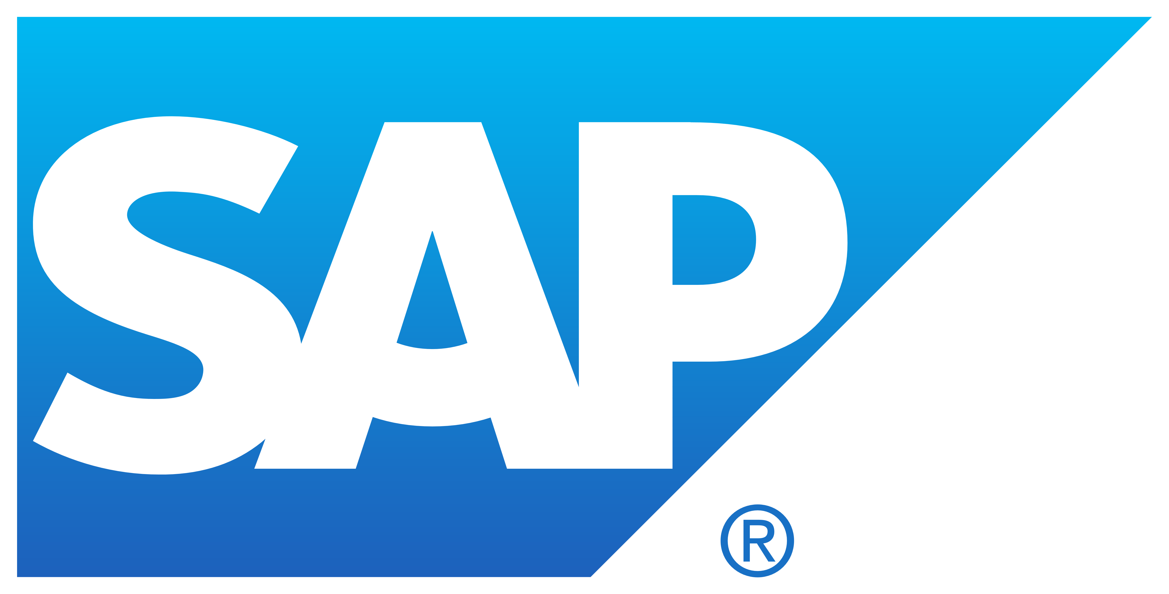
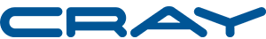


Best-in-class infrastructure for every workload
VIRTUAL MACHINES
GENERAL PURPOSE
VIRTUAL MACHINES
ENTRY LEVEL | BURSTABLE | GENERAL PURPOSE | CONFIDENTIAL COMPUTING | COMPUTE INTENSIVE
MEMORY OPTIMIZED | GPU ACCELERATED | HIGH PERFORMANCE COMPUTING | STORAGE OPTIMIZED | QUANTUM
ENTRY LEVEL | BURSTABLE | GENERAL PURPOSE | CONFIDENTIAL COMPUTING | COMPUTE INTENSIVE
MEMORY OPTIMIZED | GPU ACCELERATED | HIGH PERFORMANCE COMPUTING | STORAGE OPTIMIZED | QUANTUM
Windows Server
SQL Server
Linux
PURPOSE - BUILT
Standard SSD
Standard HDD
Standard SSD
Standard HDD
Premium SSD
Premium SSD
Ultra Disk
Ultra Disk
Notes:
Azure infrastructure is designed to run every type of workload, from general purpose workloads such as Windows Server, SQL and Linux, to specialized (or purpose-built) workloads like VMware, SAP, Cray, and NetApp.
To achieve this, Azure offers every type of virtual machine to meet your compute needs – we offer a broad VM series optimized for compute, memory, disk, or GPU intensive workloads. Regardless of where you are in your cloud journey, Azure VMs can handle entry level workloads up to quantum computing. And this portfolio is growing constantly!
We also offer a comprehensive range of disk storage solutions for every workload – from low-cost storage options for backup to high throughput, low latency storage for demanding workloads. Choose from disk storage options at various sizes (4GB to 64 TB) and price points, which enable you to optimize performance and costs by selecting the appropriate storage for your workload needs.​
​Azure Standard HDDs deliver reliable, low-cost storage for Azure virtual machines running latency-insensitive workloads. Standard HDDs are suitable for backups and less-critical workloads.​
​Azure Standard SSDs offers consistent performance and is suitable for web servers, lightly used enterprise applications.​
​Azure Premium SSDs deliver high-performance and low-latency block storage for Azure virtual machines. Premium SSDs are suitable for databases, enterprise production workloads, and container volumes.​
Azure Ultra Disks delivers high throughput, high IOPS, and sub-millisecond latency block storage for Azure virtual machines. Ultra Disks are suited for data-intensive workloads such as SAP HANA, top tier databases, and transaction-heavy workloads.​
Now let’s double click on some of these workloads you can migrate to Azure, starting with Microsoft and Linux workloads

Slide 8

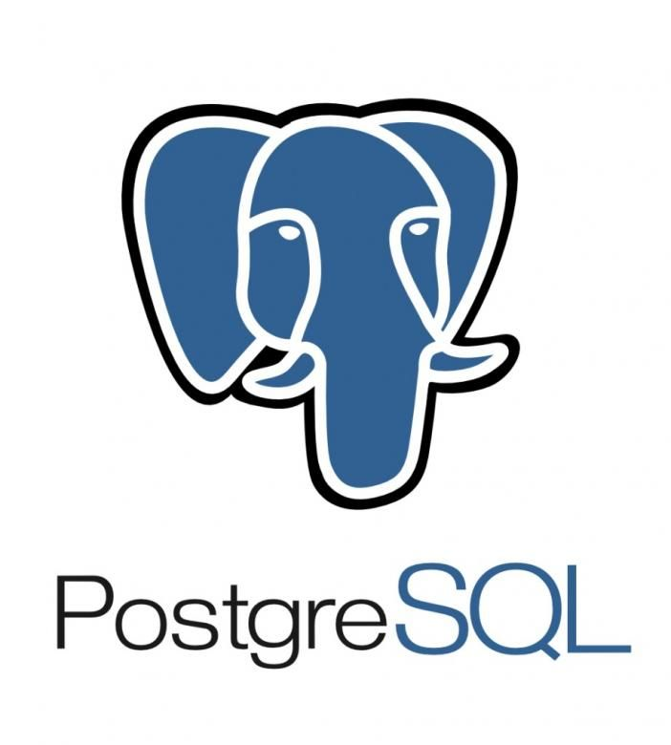
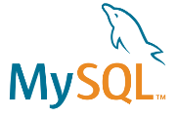

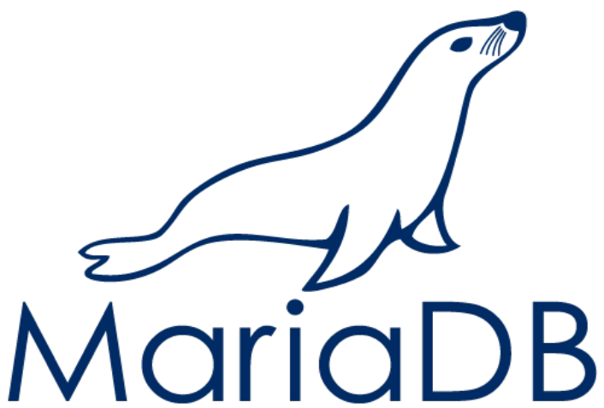



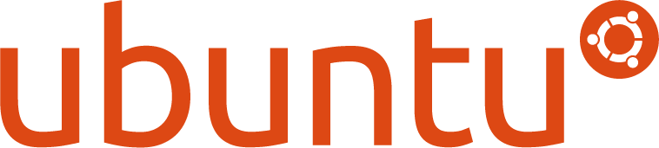



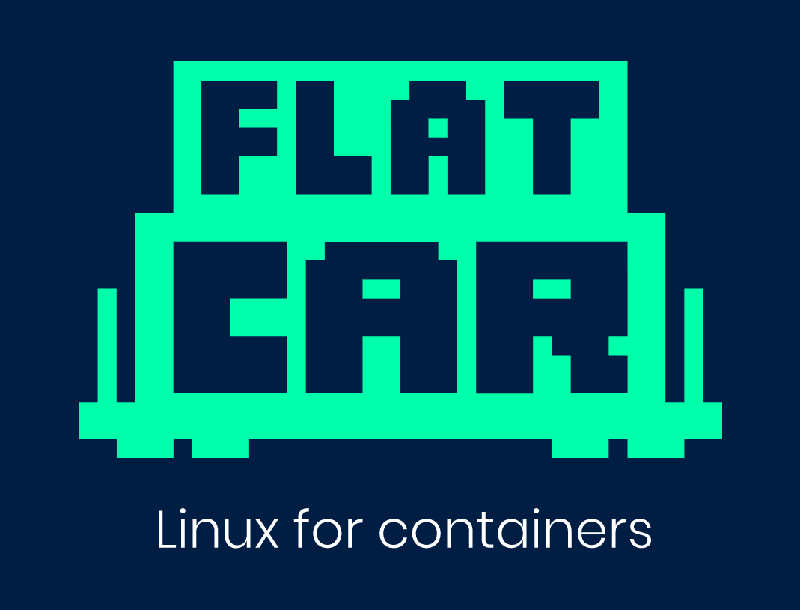




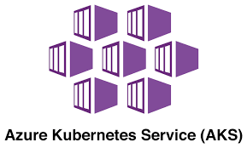

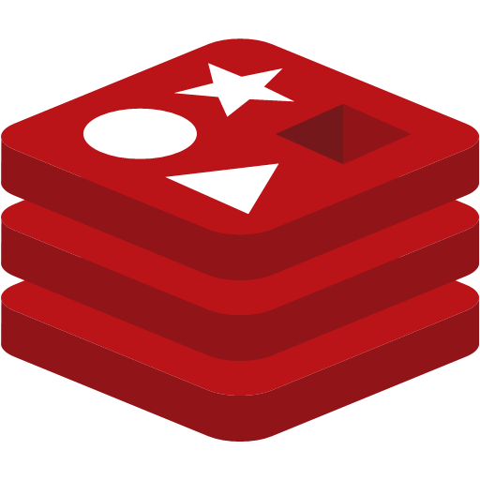
Linux and open source databases offerings on Azure
Unique Azure offerings for Linux and containers
Unique Azure offerings for SQL Server and open source databases
Integrated support
Azure Red Hat OpenShift
Ansible integration
JBoss integration
Integrated support
Azure Tuned Kernel
SAP integration
Azure Tuned Kernel
Fully supported on Azure
Fully managed container service
Compute options for every workload
Robust monitoring, backup and governance tools
Incentives to save money
Low TCO with built-in HA
Fully managed community versions
Industry-leading compliance and layers of security
Visual Studio and VS Code for Database services
Fully Managed Cache service with Redis for scalable apps
Core OS Replacement
Notes:
We’re offering three unique value to our customers:
Over 50% of the Azure VM Cores are running Linux, and we’re continuously investing more in the Linux and Open Source world to make sure that the experience of running the Linux-based workloads are seamless.
Being a neutral technology provider, We have strong partnership with the Linux Distro publishers like Red Hat, SUSE and Canonical, to build co-developed applications, Azure Tuned Kernel and we jointly support our customers when they choose to run their Linux workloads on Azure, they can enjoy one ticket to solution experience.
Top 100 Microsoft Customers using Azure are running their mission critical workloads in heterogeneous environment, and we’re also contributing back to the upstream Linux and Open Source community, to ensure the best experience possible.
Linux on Azure ACOM site: https://azure.microsoft.com/en-us/overview/linux-on-azure/
3 key messages
#1 majority of Azure customer workloads run on Linux
#2 Our key strength is in our partnersships
AL2 competes directly with Red Hat
We partner closely with the top distro providers – for Red Hat and SUSE that means joint investments in support and product integration
It means Azure tuned kernels for optimal performance on the platform
Joint marketing, product development, lab development and training
We work very closely with SAP
- We recently started partnering with Oracle
#3 top enterprise customers trust Linux on Azure with their workloads
Linux workloads are among the fastest growing workloads on Azure. In fact, more than 50% of Azure VM cores are running Linux. Top 100 Azure customers are running Linux on Azure. ​
​
Microsoft has been investing heavily in Linux and Open Source to ensure the best experience of running Linux workloads on Azure. We have strong partnership with the Linux Distro publishers like Red Hat, SUSE and Canonical, to build co-developed applications, Azure Tuned Kernel. We jointly support our customers when they choose to run their Linux workloads on Azure, so they can enjoy integrated support and timely resolution.​
​
Linux on Azure ACOM site: https://azure.microsoft.com/en-us/overview/linux-on-azure/ ​

Slide 9



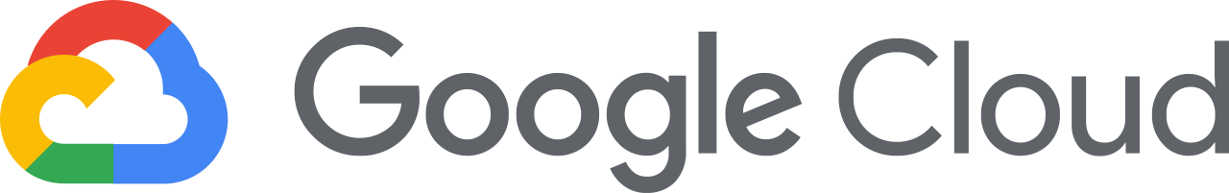

Azure Hybrid
Innovation anywhere with Azure
Azure
Single control plane with Azure Arc
Bring Azure services to any infrastructure
Modernize datacenters with Azure Stack
Extend to the edge with Azure IoT
Notes:
Azure takes a comprehensive approach and offers unique hybrid capabilities that give customers the flexibility to innovate anywhere in their environment.
Enabled by Azure Arc, you can bring Azure services to any existing infrastructure including other clouds you are using, so you can take advantage of cloud benefits everywhere, such as scalability, fast deployment, and always up-to-date cloud innovation.
You can build Azure-consistent new cloud infrastructure in your own datacenter with Azure Stack, so you can modernize your datacenter and run cloud native applications on-premises while taking advantage of existing investments and meeting regulatory compliances.
You can extend AI to edge devices with Azure IoT, so you can run machine learning and advanced analytics close to the users and the data. As a result, you can gain real-time insights and deliver immersive experiences at the edge of your network, opening up endless new business opportunities.
And you can do it all using Azure Arc as the single control plane to seamlessly manage and secure your IT resources, such as Linux/Windows VMs and Kubernetes clusters, across multicloud, on-premises and the edge.
Now let’s take a deeper look at the three hero Hybrid offerings: Azure Arc, Azure Stack and Azure IoT

Slide 10
2. Use Azure Migrate as the tool
Notes:
Using Azure Migrate as the tool
Before Azure Migrate: understand Azure migration readiness with SMART (aka.ms/smartool)
Use Azure Migrate to plan, execute, and track migration
Using Azure Migrate to Assess
Server assessment – server discovery & analyze dependencies, cost estimation, and VM size recommendations
Database assessment with Azure Migrate – DMA report comes back with SKU recommendations, cost estimations
Using Azure Migrate to Migrate
Test and then migrate
CTAs
Learn more on Website: aka.ms/azuremigrate
Launch Azure Migrate and start your assessment

Slide 11
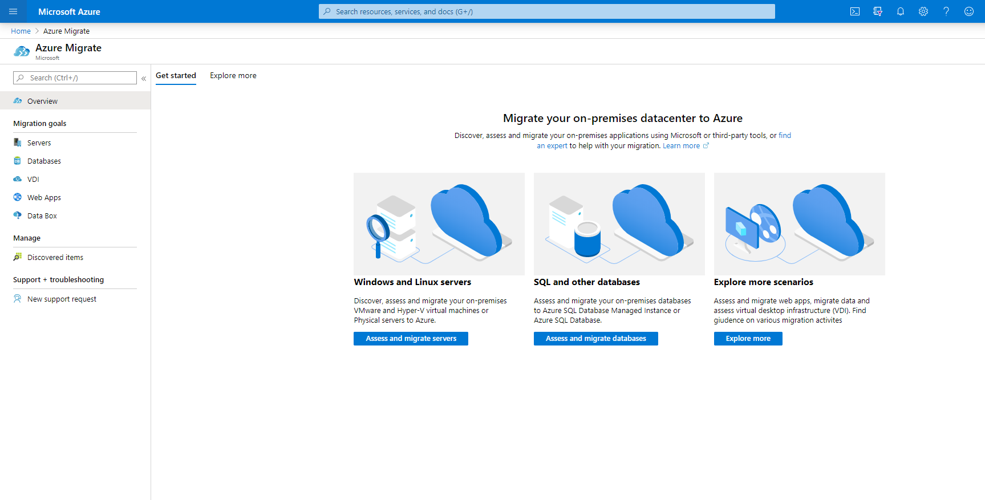
Perform your migration with Azure Migrate
Step 1: Discover your on-prem or other cloud datacenter environment
Step 2: Assess dependencies, Azure readiness, costs, and Azure sizing
Step 3: Test and migrate workloads to Azure
Get Started
Launch Azure Migrate from the Azure portal to run a free assessment today
Learn more at aka.ms/azuremigrate

Slide 12
3. Benefit from the Azure Migration Program
Notes:
Joining AMP / Azure Advanced Specialization Partner Program / Azure Support
(From presentation) The Azure Migration Program gives you prescriptive guidance for a step by step approach to cloud migration. AMP offers the opportunity to work closely with Microsoft experts and specialized migration partners to simplify and accelerate your migration.
CTAs
Learn more and find resources: Azure.com/migration
Nominate your customers to Azure Migration Program, it is now supporting Windows and Linux Migration Scenarios
Sign up at Azure.com/AMP
Nominate yourself as a partner to Azure Migration Program, and Join Advanced Specialization Partner program to be eligible of collecting the migration support from Microsoft for your customers.
Getting Azure Support plans for your customers so they can enjoy the industry unique integrated support with Red Hat / SUSE / SAP and for their tech stack running on Azure

Slide 13
Azure Migration Program (AMP)
Optimize costs and migrate with confidence with the right expert help at every stage. Use best-practice guidance, direct access to Azure engineers, tools, and specialized partners.
Proven methodology: Cloud Adoption Framework
Free tools: Azure Migrate
Cost-effective offers & incentives
In-depth assistance from FastTrack for Azure engineers
Technical skill building
Expert help from specialized partners
Learn more & nominate | Azure.com/AMP
Notes:
The Azure Migration Program gives you prescriptive guidance for a step by step approach to cloud migration. AMP offers the opportunity to work closely with Microsoft experts and specialized migration partners to simplify and accelerate your migration.
The program delivers:
Best practices for a step by step approach from start to finish
Technical skill building to ensure your organization can successfully adopt Azure
FastTrack for Azure engineering assistance for data and infrastructure foundations
Expert guidance from specialized migration partners
Free Azure tools like Azure Migrate to help you efficiently execute migrations
And cost effective offers to help you save money before, during, and after migration

Slide 14
Start with a Solution Assessment…
Learn more and find resources
Azure.com/migration
Sign up for assistance
Azure.com/AMP
Azure.com/fasttrack
Understand Azure migration readiness
aka.ms/smarttool
Assess and move your workloads
aka.ms/azuremigrate
Notes:
https://www.microsoft.com/en-us/sam/use-cases.aspx – for more info on Solution Assessments

Slide 15
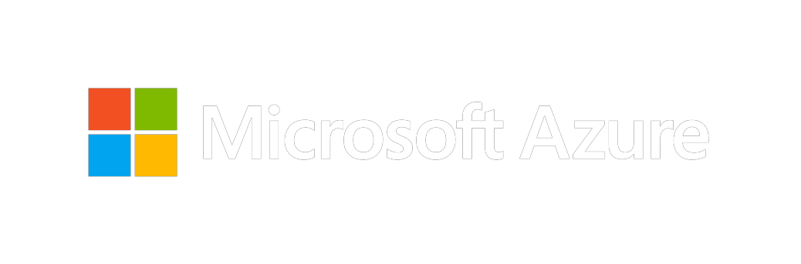
Thank you for joining us.
© 2018 Microsoft Corporation. All rights reserved. Microsoft, Windows, Windows Vista and other product names are or may be registered trademarks and/or trademarks in the U.S. and/or other countries.
The information herein is for informational purposes only and represents the current view of Microsoft Corporation as of the date of this presentation. Because Microsoft must respond to changing market conditions, it should not be interpreted to be a commitment on the part of Microsoft, and Microsoft cannot guarantee the accuracy of any information provided after the date of this presentation. MICROSOFT MAKES NO WARRANTIES, EXPRESS, IMPLIED OR STATUTORY, AS TO THE INFORMATION IN THIS PRESENTATION.

